Slide 1
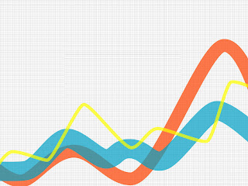

Data-Driven Decision Making for Saeed Mega Mart: A Case Study of Employing Sales Forecasting, Customer Segmentation, and Sentiment Analysis Strategies
BDM Capstone Project
ANEEQA HAROON SIDDIQUI
21f2000377
21f2000377@ds.study.iitm.ac.in

Slide 2
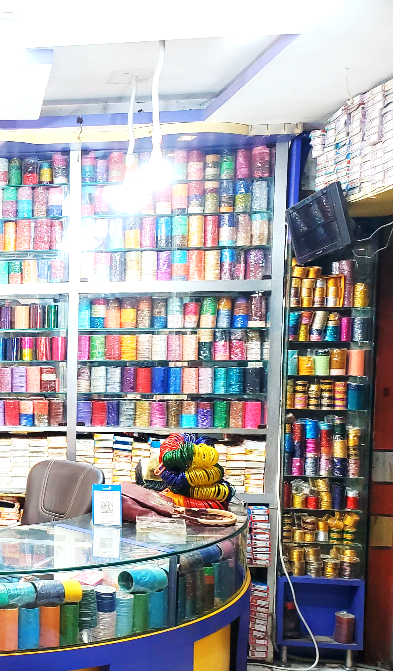
Organisation Background
Location: Sandila, Uttar Pradesh.
Type: Family-owned business.
Founder: Mr. Mukeed.
Established: 6-7 years ago.
Initial Product: Bangles.
Current Products: Bangles, cosmetics, handbags, jewellery, and gift items.
Customer Base: Local community.
Management: Assisted by Mr. Mukeed’s sons.

Slide 3



Objective of the Project
Optimize Saeed Mega Mart’s business performance using data-driven methods.
Improve sales forecasting and analysis considering daily sales data and external factors like seasonality, festivals, and competition.
Enhance customer segmentation and loyalty using customer data and feedback.

Slide 4
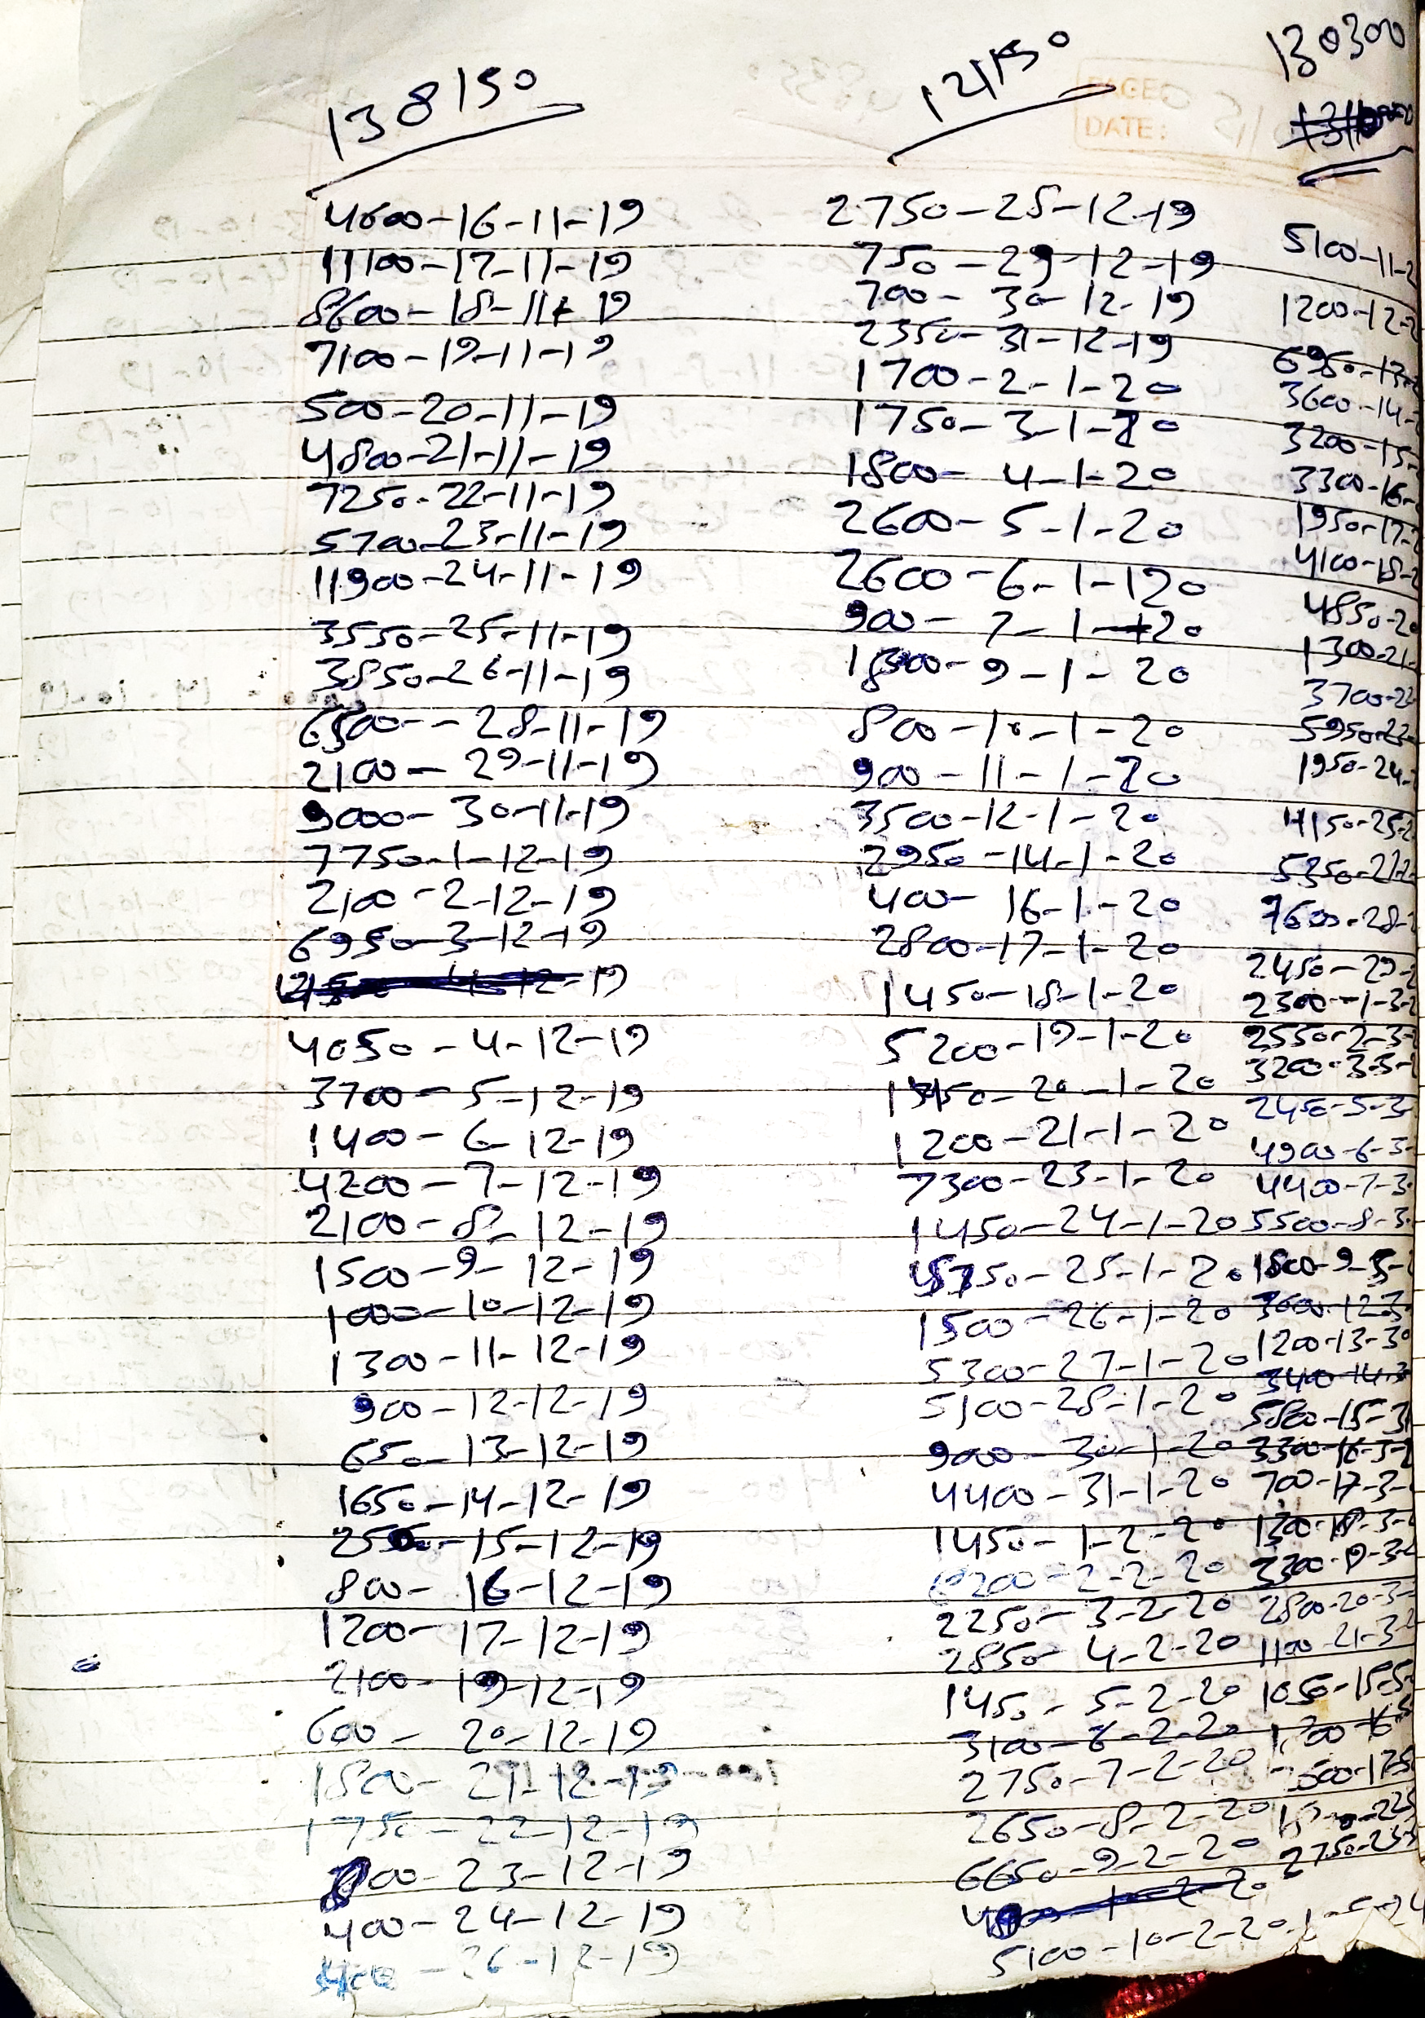
Data Collection and Cleaning
Sales Analysis:
Daily sales revenue recorded and manually entered into an Excel spreadsheet.
Raw data is taken from mid-Nov 2019 to Sept 2023.
Data cleaned using Python, missing values filled with median value.
Customer Feedback Analysis:
Google Form used to collect customer feedback.
Data cleaned using Python, columns renamed, and ‘customer_suggestions’ column removed due to high percentage(70%+) of missing values.
Column | Percentage Missing
Date | 0%
Daily Sales Revenue | 30.08%

Slide 5
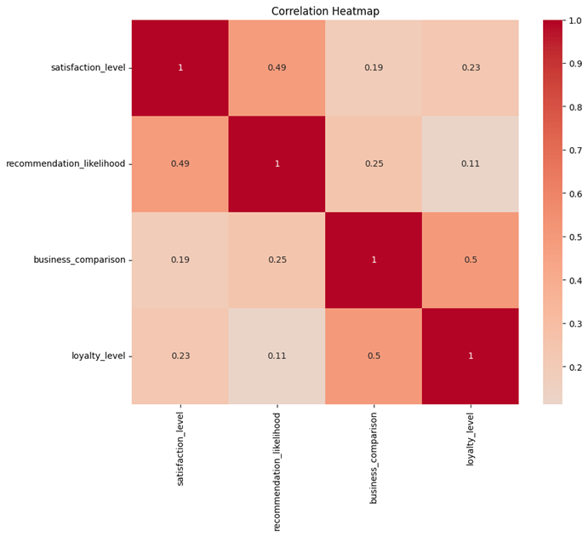
Descriptive Analysis
(Sales Data)
Correlation Analysis
(Customer Data)
 | Daily Sales Revenue
count | 990
mean | 2818.83939
std | 2425.2331
min | 100
25% | 1300
50% | 2025
75% | 3500
max | 23300

Slide 6
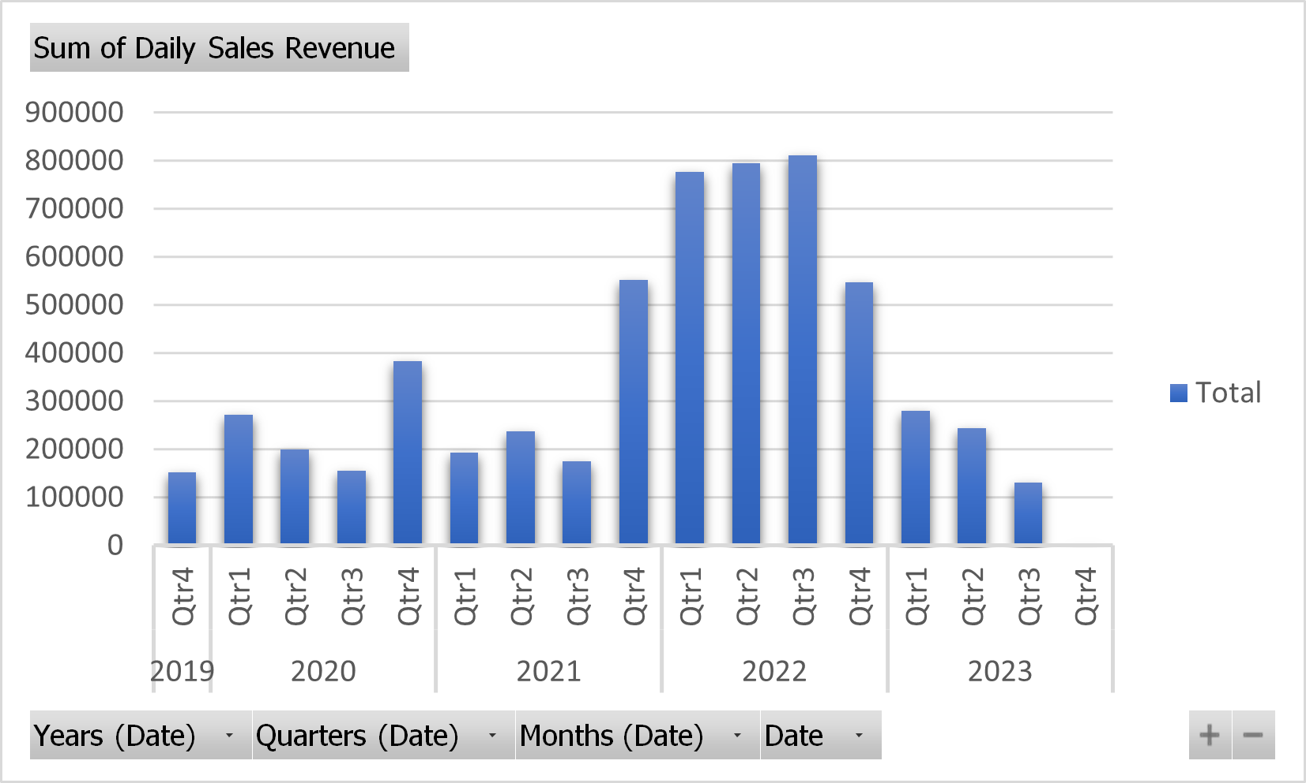
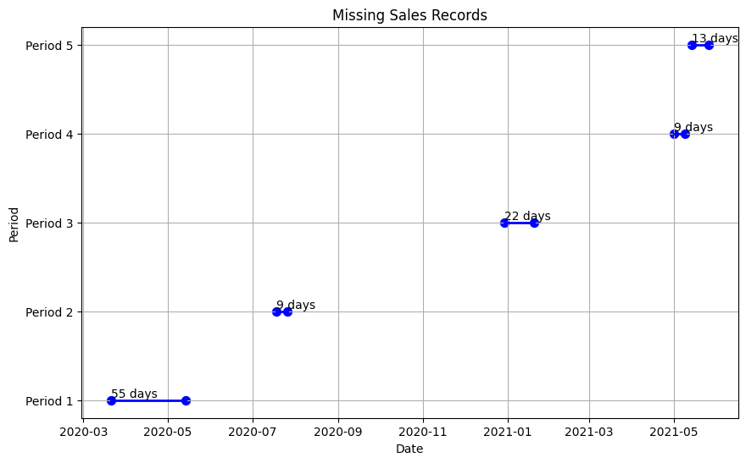
Quarterly Sales Revenue Trends
(2019-2023)
Missing Value Analysis
The longest period of missing records coincides with the first nationwide lockdown in India due to the COVID-19 pandemic.
Overall trend shows a peak in sales revenue in 2022 followed by a decline in 2023.

Slide 7
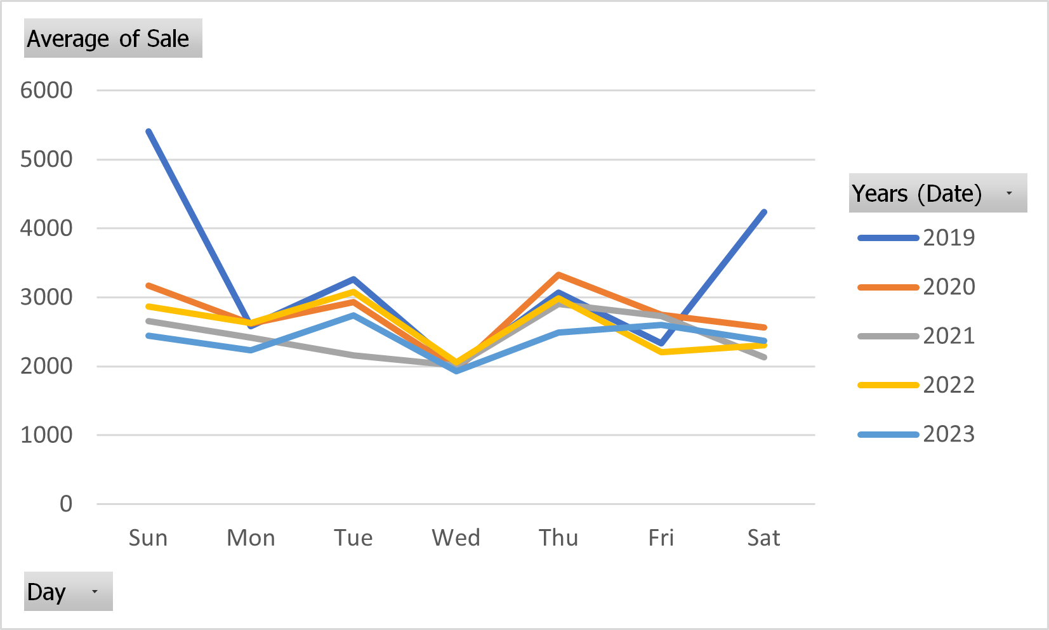
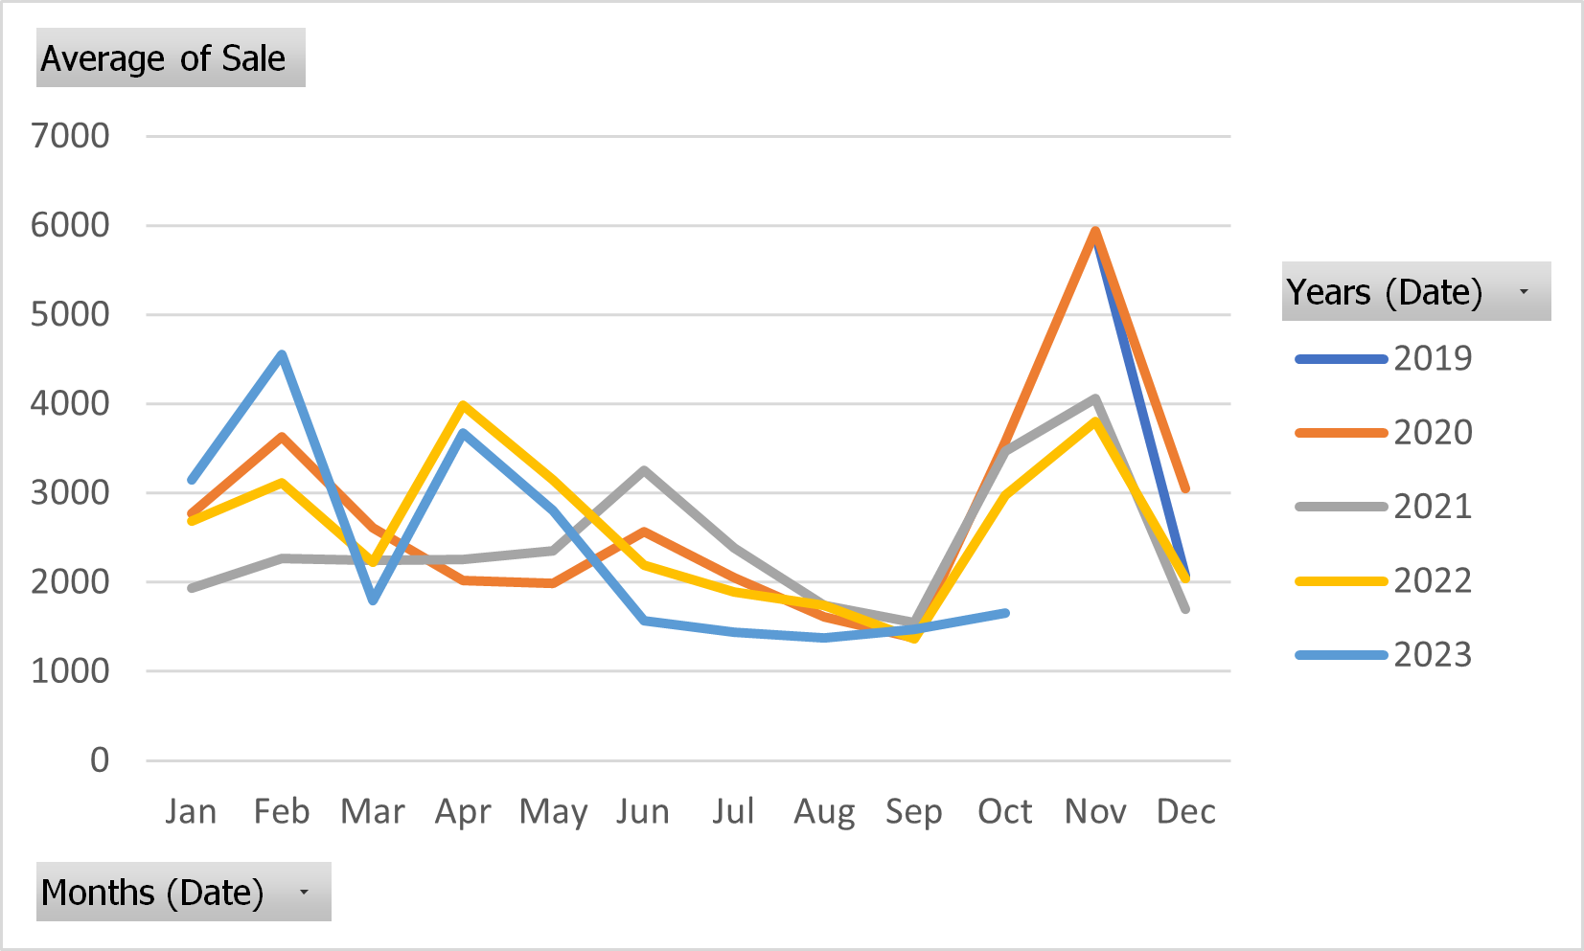
Weekly Sales Trend Analysis
(2019-2023)
Monthly Sales Trend Analysis
(2019-2023)
Sunday, Tuesday and Thursday being the most profitable days and Wednesday being the least profitable day.
Increase in sales can be seen in the last quarter probably due to increase in festivals and marriages.

Slide 8
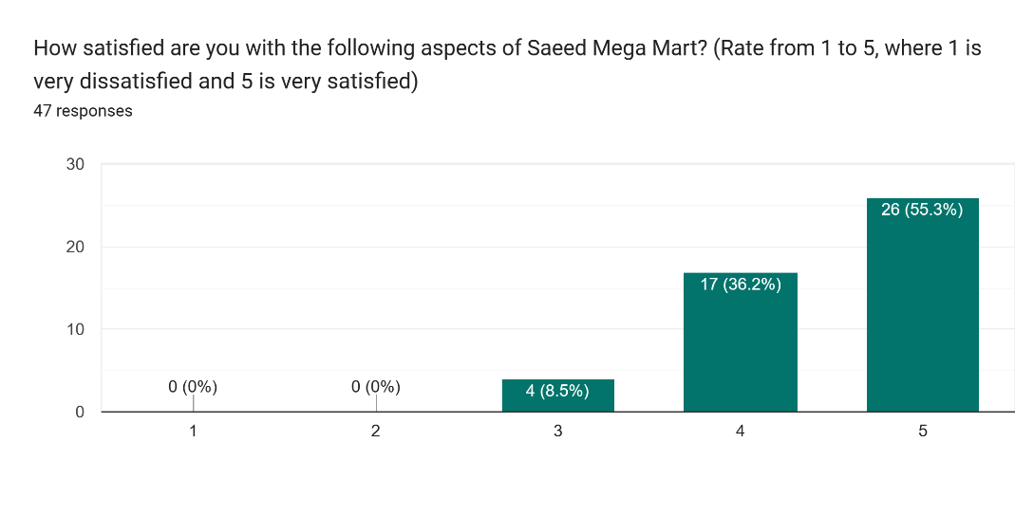
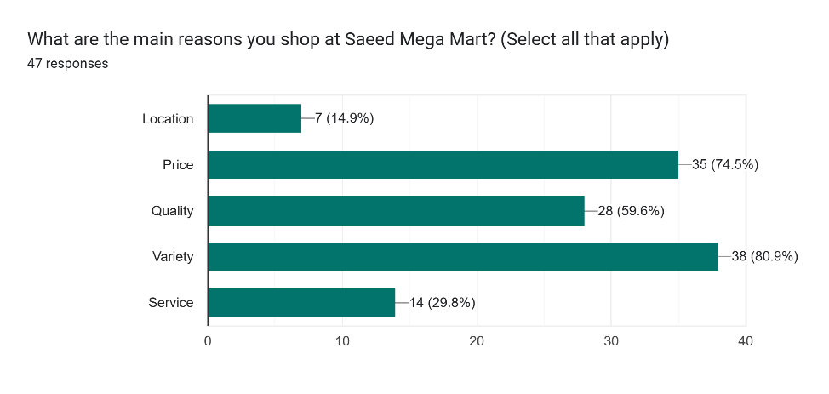
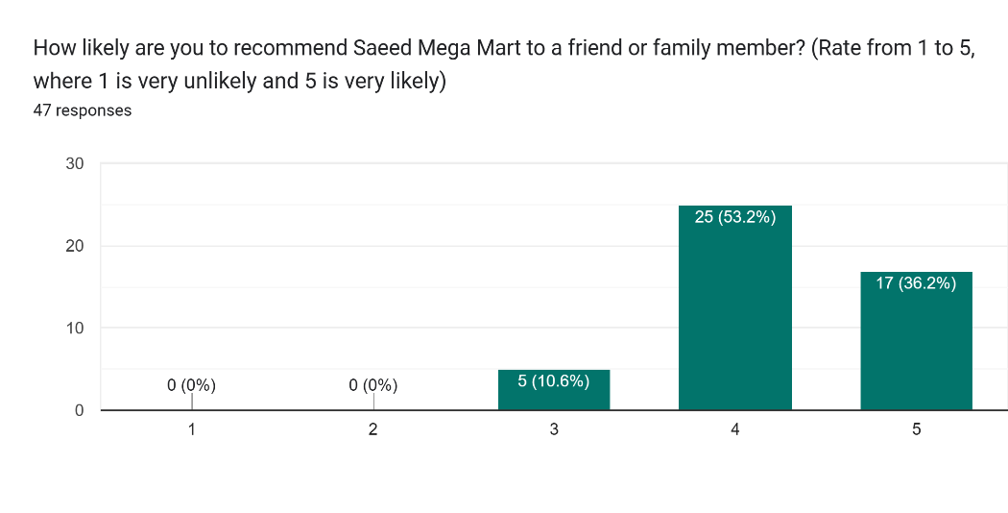
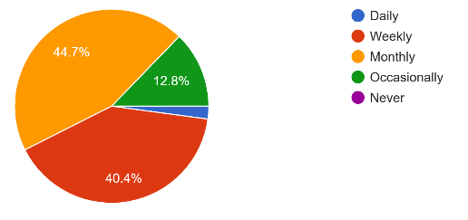
Shopping Reason
Satisfaction-Level
Customer prefers shopping monthly and weekly.
Shopping reasons are affordable prices and huge variety of quality products.
Majority of the customer is Satisfied with the services and products provided by Saeed Mega Mart.
Shopping Frequency
Loyalty-Level

Slide 9
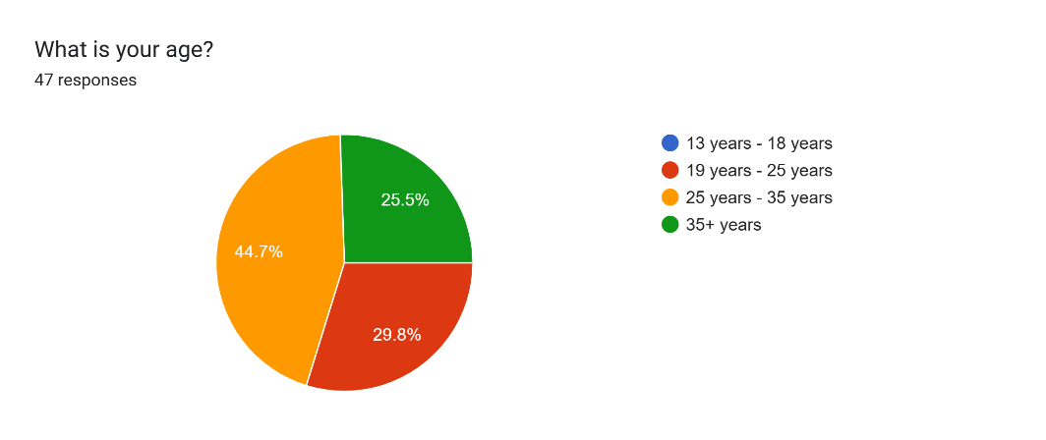
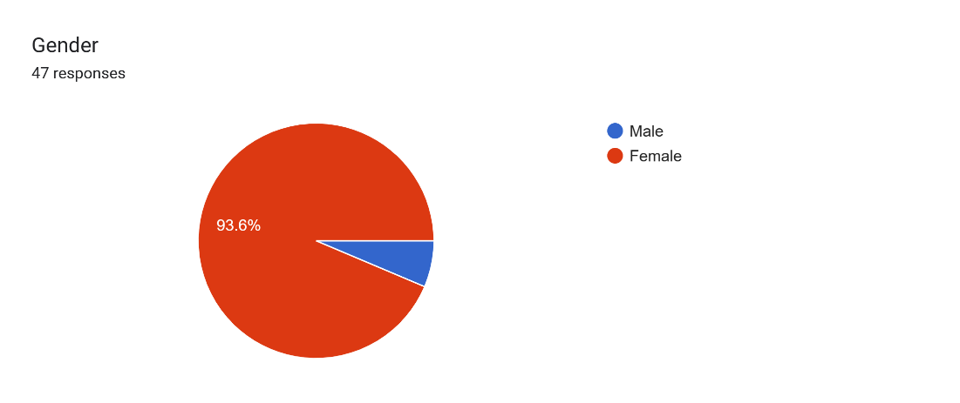
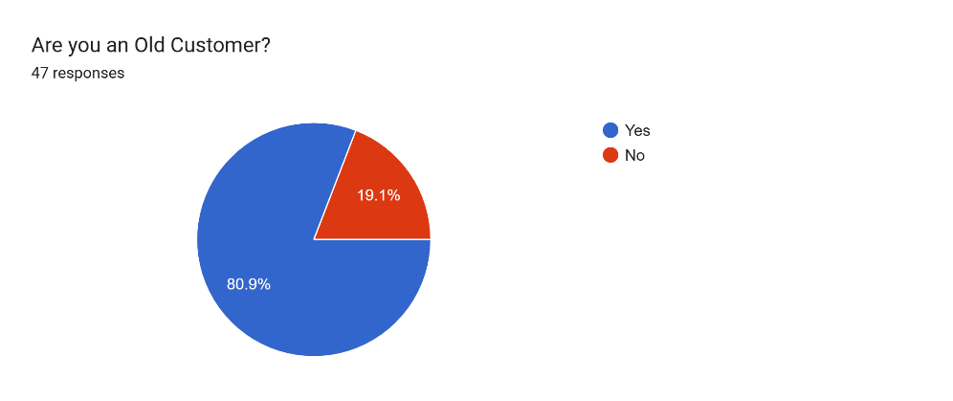
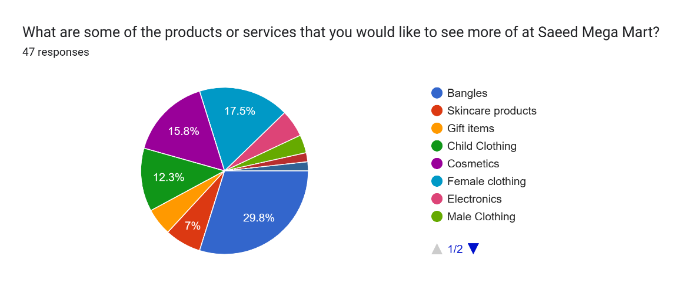
Customer-Age
Customer-Gender
Most of the customers are loyal to the shop and they are old customer.
Majority of the customers are female and belongs to the age of 25+ years.
Most desired products are Bangles, female clothing, cosmetics etc.
Desired Products
Old Customer

Slide 10
Recommendations
Investigate the factors contributing to the sales decline in 2023.
Maintain product quality and variety, and consider special deals during peak shopping periods.
Implement customer loyalty programs to enhance customer retention.
Tailor marketing strategies to cater to the majority demographic (female, 25+ years).
Continue leveraging strengths and look for areas of improvement based on customer feedback and market trends.

